Slide 1
Mini siri
Your Smart Assistant

Slide 2
The General Idea & how it works
Mini Siri
2

Slide 3
The General idea
- Mini-Siri is a virtual assistant, The general idea behind Mini-Siri is to provide users with a voice-activated interface to interact with their devices using natural language.
- Mini-Siri is designed to perform various tasks and answer questions, acting as a personal assistant that can help users with a wide range of functions.
- Mini-Siri uses advanced natural language processing and machine learning technologies to understand and interpret user commands, making it capable of handling a variety of tasks.
3
Mini Siri

Slide 4
The targeted categories
Mini Siri
4

Slide 5
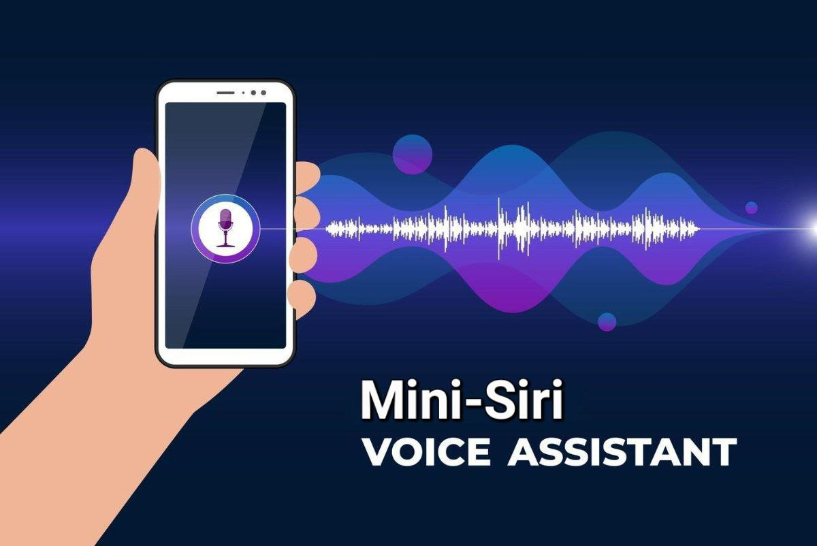
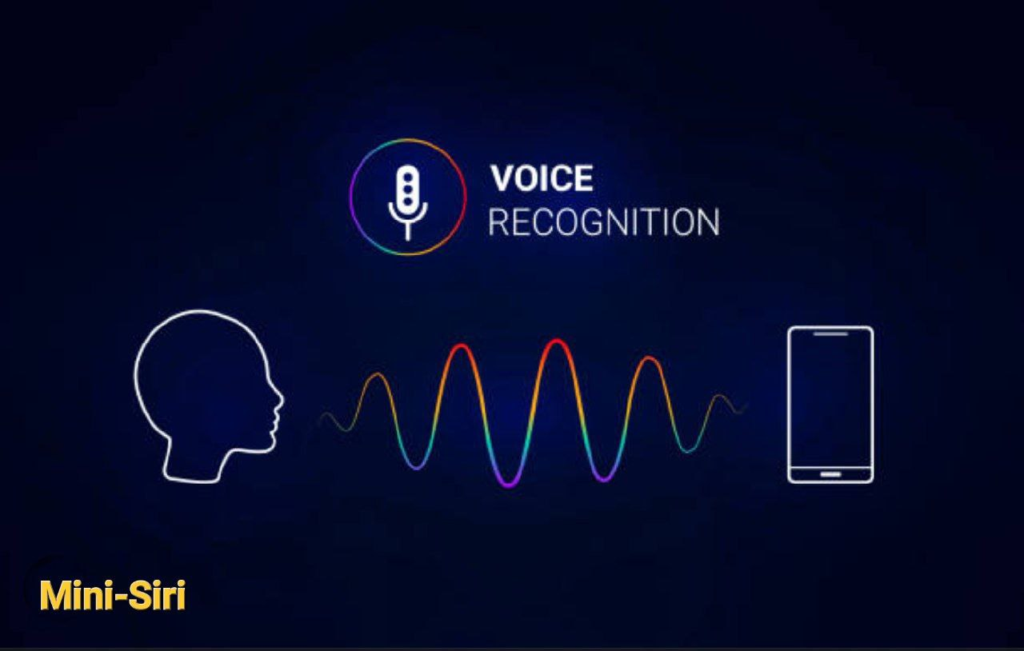
Targeted Categories By Mini-Siri :
- People with physical disabilities.
(People with Accessibility Needs)
- It help people with their needs from the device (handsfree) when they can’t reach-out their device.
- Students: Mini-Siri can assist with searching for information, solving equations, and providing quick access to information for studies.
- Smart Home (IOT): Mini-Siri can be used to control smart home devices, making it appealing to individuals who have integrated smart technologies into their homes.
5
Mini Siri

Slide 6
Our Target from the idea
Mini Siri
6

Slide 7
The target from mini-siri :
It provide users with a convenient and efficient way to interact with technology and perform various tasks. The primary objectives of Mini-Siri are:
- Increase Efficiency :
The goal is to help users save time and effort by automating routine tasks. Mini-Siri can perform a variety of functions, such as opening apps, search and providing information, more quickly than traditional methods.
- Improve Accessibility:
Mini-Siri play a crucial role in enhancing accessibility for individuals with disabilities. Voice-activated interfaces, it can be particularly valuable for people with mobility issues or those who may have difficulty using traditional input methods.
7
Mini Siri

Slide 8
The target from mini-siri :
- Provide Information and Assistance:
Mini-Siri are designed to offer information and assistance across a wide range of topics. Users can ask questions, get weather updates, receive news briefings, and more, contributing to a more informed and connected user experience.
- Facilitate Hands-Free Operation:
Mini-Siri enable hands-free operation, allowing users to perform tasks while driving, cooking, or engaging in other activities where hands may be occupied.
By achieving these goals, Mini-Siri aim to create a more user-centric and intuitive interaction between individuals and their devices, ultimately enhancing the overall user experience.
8
Mini Siri

Slide 9
How it works ?!
Mini Siri
9

Slide 10
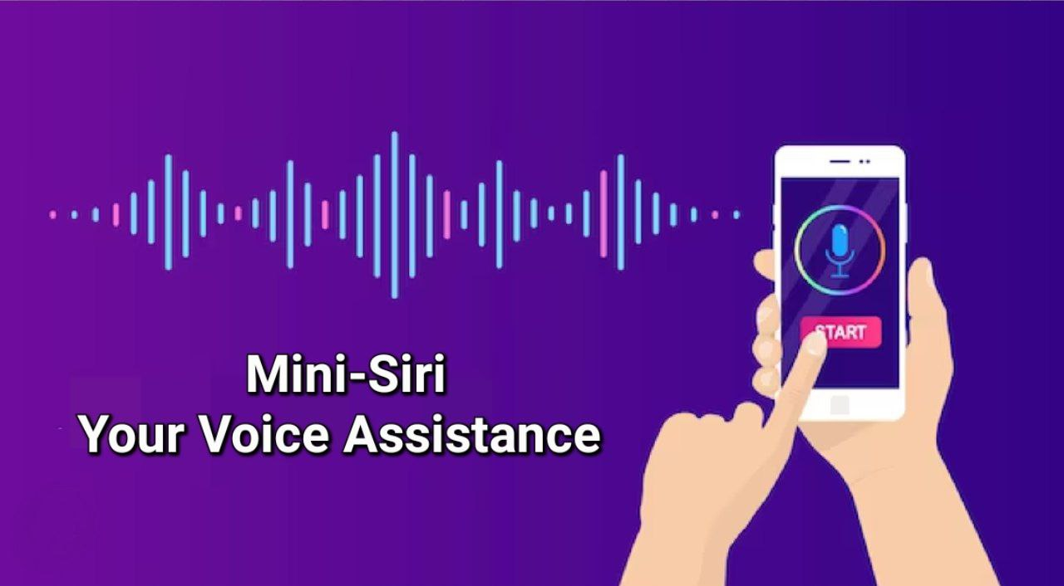
Mini Siri
How does mini-siri work ?
Mini-Siri work through a combination of natural language processing (NLP) and machine learning algorithms, Here's a general overview
of how Mini-Siri function:
1- Speech Recognition :
The interaction with Mini-Siri often begins with speech recognition. When a user activates it, the device's microphone captures the user's voice command.
2- Audio-to-Text Conversion :
The captured audio is then converted into text using speech recognition algorithms. This process, known as automatic speech recognition (ASR), transforms the spoken words into a format that the system can analyze and understand.
10

Slide 11
How does mini-siri work ?
3- Natural Language Processing (NLP) :
NLP is a key component of Mini-Siri. Once the user's command is converted to text, NLP algorithms analyze and understand the meaning behind the words. This involves parsing the syntax, understanding semantics, and identifying the user's intent.
4- Task Execution :
Based on the recognized intent and the user's request, Mini-Siri then performs the necessary actions. This could involve opening a specific app, accessing online services, or triggering device-specific functions.
11
Mini Siri

Slide 12
How does mini-siri work ?
Mini Siri
5- Response Generation :
Mini-Siri then generates a response, which is displayed in the form of text. The response is designed to provide the user with the information they requested or to confirm that a task has been executed.
By combining these technologies, Mini-Siri aim to understand and respond to user queries in a way that simulates natural conversation, providing a more intuitive and user-friendly experience.
12

Slide 13
Disadvantages of Mini-siri
Mini Siri
13

Slide 14
Disadvantages
of Mini-siri
1- Security Risks :
As with any technology connected to the internet, Mini-Siri are vulnerable to security risks. There is a potential for unauthorized access, hacking, or misuse of personal information.
2- Misinterpretation of Commands :
Mini-Siri may misinterpret user commands, especially if the commands are ambiguous or spoken unclearly. This can lead to unintended actions or frustrating user experiences.
3- Limited Understanding and Context :
Mini-Siri still may struggle with understanding complex
commands. Users may need to provide specific
instructions or commands for more accurate results.
14
Mini Siri

Slide 15

Disadvantages
of Mini-siri :
4- Dependency and Reduced Autonomy:
Overreliance on Mini-Siri may lead to a reduction in users' ability to perform certain tasks independently. Some users might become dependent on Mini-Siri for simple actions, potentially hindering their problem-solving skills.
5- Connectivity Issues:
Mini-Siri heavily rely on internet connectivity. In cases of poor or no connectivity, the functionality of the assistant will be limited, hindering its ability to retrieve information or perform tasks.
6- Limited Language Support:
Sadly, Mini-Siri doesn’t support multiple languages,Users
who speak languages other than English will not experience the same functionality.
15
Mini Siri

Slide 16





PLAN FOR mini-siri LAUNCH
PLANNING
STRATEGY
DESIGN
MARKETING
LAUNCH
- Develop a detailed project plan outlining tasks, milestones, and timelines.
- Assign responsibilities to team members.
- Conduct thorough testing to identify and fix bugs.
- Ensure the project meets quality standards.
- Design the project architecture and user interface.
- Begin development, keeping in mind scalability and future updates
- Develop a marketing strategy to create awareness.
- Utilize various ways to promote your project.
- Set a launch date
- Monitor the launch process to address any issues that may arise.
Mini Siri

Slide 17
Future aspirations
Mini Siri
17

Slide 18
Future aspirations
for mini-siri :
- Learning and Adaptation:
To continuously learn from user interactions to improve their performance over time. it adapt to user preferences over time, refine language understanding, and update their knowledge base based on new information, it improves the accuracy of responses.
- Translation :
Translating phrases or sentences into different languages.
- Mathematics and Conversions:
Performing calculations.
Converting units of measurement.
3
Mini Siri

Slide 19
Future aspirations
for mini-siri :
- Support Multimodal Interaction:
It will be capable of handling multimodal interactions, combining voice, text, and touch inputs. This flexibility allows users to choose the most convenient and effective method for a given situation.
- Health and Fitness:
Providing health and fitness-related information.
Setting health-related reminders.
- Device Integration:
Personal assistants are integrated into various devices and ecosystems. Allowing seamless communication and coordination between different devices.
3
Mini Siri

Slide 20
THANK YOU ❤️
Mini Siri Team
Samer Wael – Ahmed Sameh
We hope that you liked Mini-Siri & It’s Presentation ✨
We look forward to you providing us with some advice so that we can develop the project ❤️
Mini Siri

